Slide 1
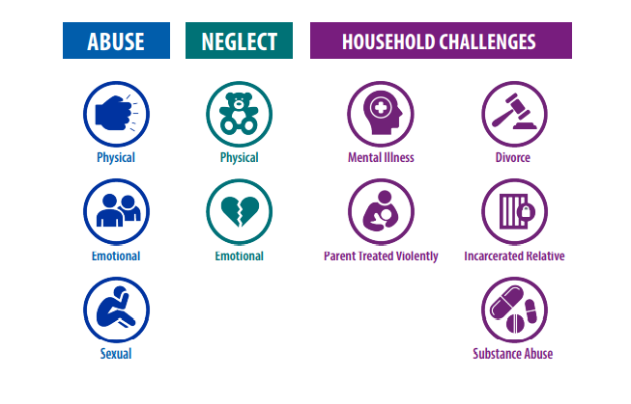
Adverse Childhood Experiences
ACEs
Notes:
ACEs: Definition
Level: Beginning
Discussion:
ACEs are an important topic in the Trauma conversation. The ACE questionnaire (copy found below for handout use) was developed in the late 1990's by Felitti et al. And measures one's adverse childhood experiences. ACEs are not inclusive of every possible traumatic event in childhood but are a way that researchers have studied the correlation between childhood trauma and health, socioeconomic, behavioral, and other outcomes in adulthood.
The study
The (ACE) Study is one of the largest investigations ever conducted to assess associations between childhood adversity and later-life health and well-being. The ACE Study findings suggest that certain experiences are major risk factors for the leading causes of illness and death, as well as poor quality of life in the United States.
The Adverse Childhood Experiences (ACE) Study involved asking a large sample of middle-class adults about 10 categories of stressful childhood experiences (listed on this slide). The study found higher than expected rates of abuse, neglect, and household dysfunction in those individuals who experienced chronic heath issues.
The initial study with middle class females was expanded nationally. Since the original study, the Federal Center for Disease Control, many states and local jurisdictions are collecting this data. They have expanded to also look at poverty, crime, neighborhood data that also has been provide to contribute to adversity and overall well-being.
Optional Learning Activity: Have participants fill out the ace survey as they listen to the presentation. Do not share individual results. http://www.aceresponse.org/img/uploads/file/ace_score_questionnaire.pdf
Additional Learning About ACEs
Michigan ACE Initiative [YouTube Channel]. (2019, May 24). Building Resilience, Healing Communities- Michigan ACE Initiative 2019. https://www.youtube.com/watch?v=XM4o50q8r5g
Sources:
Felitti, V. J., Anda, R. F., Nordenberg, D., Williamson, D. F., Spitz, A. M., Edwards, V., Koss, M. P., & Marks, J. S. (1998). Relationship of childhood abuse and household dysfunction to many of the leading causes of death in adults. The Adverse Childhood Experiences (ACE) Study. American journal of preventive medicine, 14(4), 245–258. https://doi.org/10.1016/s0749-3797(98)00017-8
Center for Disease Control and Prevention [CDC]. (2020, Sep). Adverse Childhood Experiences Prevention Strategy: FY2021-FY2024. https://www.cdc.gov/injury/pdfs/priority/ACEs-Strategic-Plan_Final_508.pdf#:~:text=A%20recent%20analysis%20by%20CDC%20%28Merrick%20et%20al%2C,overweight%20or%20obesity%20to%2044%25%20for%20depressive%20disorder.

Slide 2
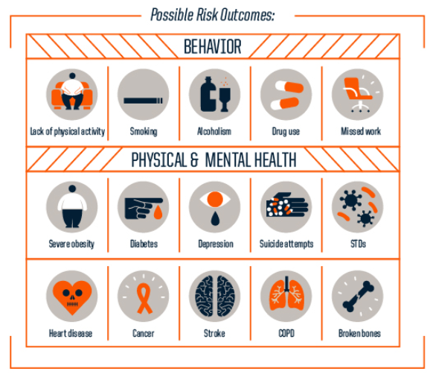
ACEs
Outcomes
Notes:
ACEs: Outcomes 1
Level: Beginning
Discussion: This slide shows the results of Felitti et al., (1998) as it relates to the correlation between number of ACEs and rate of health conditions including smoking, alcoholism, illicit drug use, heart disease, and suicide attempts.
As the number of ACEs experienced rises, so does the percentage of people experiencing each condition.
The greater study found:
a "Graded relationship between the number of categories of childhood exposure and each of the adult health risk behaviors and diseases that were studied," such as ischemic heart disease, cancer, chronic lung disease, skeletal fractures, and liver disease.
For those with 4+ ACEs, "compared to those who had experienced none, had 4- to 12-fold increased health risks for alcoholism, drug abuse, depression, and suicide attempt; a 2- to 4-fold increase in smoking, poor self-rated health..." (Felitti et al., 1998)
Sources:
Felitti, V. J., Anda, R. F., Nordenberg, D., Williamson, D. F., Spitz, A. M., Edwards, V., Koss, M. P., & Marks, J. S. (1998). Relationship of childhood abuse and household dysfunction to many of the leading causes of death in adults. The Adverse Childhood Experiences (ACE) Study. American journal of preventive medicine, 14(4), 245–258. https://doi.org/10.1016/s0749-3797(98)00017-8

Slide 3
ACEs
Outcomes
No ACEs: 33% | 3 ACEs: 51% | 7+ACES: 16%
1 in 16 smokes 1 in 69 alcoholic 1 in 480 IV drugs 1 in 14 heart disease 1 in 96 attempts suicide | 1 in 9 smokes 1 in 9 alcoholic 1 in 43 IV drugs 1 in 7 heart disease 1 in 10 attempts suicide | 1 in 6 smokes 1 in 6 alcoholic 1 in 30 IV drugs 1 in 6 heart disease 1 in 5 attempts suicide
http://www.cdc.gov/ace/index.htm
Notes:
ACEs Outcomes 2
Level: Beginning/Intermediate/Clinical (For higher levels, quickly review ACEs study)
Discussion
This table describes that probability of some of these negative outcomes as they relate to ACE scores.
For those with No Aces, which is 33% of the population only 1 in 16 adults smoke, for those with 3 ACEs which is 51 % of the population 1 in 9 will smoke, for those with 7 or more ACEs 1 in 6 will smoke.
For those with No Aces, 1 in 69 area alcoholic, for those with 3 ACEs 1 in 9 are alcoholic, for those with 7 or more ACEs 1 in 6 is alcoholic
For those with No Aces, 1 in 480 are IV drug users, for those with 3 ACEs 1 in 43 are IV drug users, for those with 7 or more ACEs 1 in 30 uses IV drugs.
For those with No Aces, 1 in 14 have heart disease, for those with 3 ACEs 1 in 7 have heart disease, for those with 7 or more ACEs 1 in 6 has hear disease.
For those with No Aces, 1 in 96 attempts suicide, for those with 3 ACEs 1 in 10 attempts suicide, for those with 7 or more ACEs 1 in 5 attempts suicide.
To date, ACEs have been associated with more than 40 such outcomes, including health risk behaviors, chronic health conditions, infectious diseases, limited educational and economic opportunity, and early death. (CDC, 2020).
Refer to the Centers for Disease Control and Prevention website (http://www.cdc.gov/ace/index.htm) for more information about the ACE Study.
Sources:
Center for Disease Control and Prevention [CDC]. (2020, Sep). Adverse Childhood Experiences Prevention Strategy: FY2021-FY2024. https://www.cdc.gov/injury/pdfs/priority/ACEs-Strategic-Plan_Final_508.pdf#:~:text=A%20recent%20analysis%20by%20CDC%20%28Merrick%20et%20al%2C,overweight%20or%20obesity%20to%2044%25%20for%20depressive%20disorder.
Felitti, V. J., Anda, R. F., Nordenberg, D., Williamson, D. F., Spitz, A. M., Edwards, V., Koss, M. P., & Marks, J. S. (1998). Relationship of childhood abuse and household dysfunction to many of the leading causes of death in adults. The Adverse Childhood Experiences (ACE) Study. American journal of preventive medicine, 14(4), 245–258. https://doi.org/10.1016/s0749-3797(98)00017-8

Slide 4
ACEs
How do childhood experiences lead to these rates of worsened health in adulthood?
Neurobiological Effects
Long-term Consequences
Disease and Disability
Social Problems
Psychosocial Effects
Health Risk Behaviors
Abuse and Neglect
Adverse Childhood Experiences
Household Dysfunction
Impact on Child Development
Notes:
ACEs: Outcomes
Level: Beginning/Intermediate/Clinical
Discussion
Adversity, specifically abuse, neglect and other household dysfunction (the 10 ACEs from previous slides) have an impact on child development.
Specifically they impact neurobiological development – this can include stress tolerance, emotional regulation and learning. When the brain is focused on survival and managing stressors, the neural pathways that support learning can be underdeveloped and this can impact learning and the ability to problem solve.
Psychosocial effects include attachment and the ability to develop and maintain relationships, social and relationship skill deficits may be present.
Adversity impacts problem solving and stress management skills. Exposure to adversity can lead to increased health risk behaviors – these includes smoking, substance use, early sexual behavior or risky sexual behavior
Together this developmental impact has long term consequences into adulthood that include disease, disability and a whole host of social problems.
Sources:
Sourced from: Williams-Hecksel, C. (2021, Nov 1). Trauma Informed Teaching. [PowerPoint].
Felitti, V. J., Anda, R. F., Nordenberg, D., Williamson, D. F., Spitz, A. M., Edwards, V., Koss, M. P., & Marks, J. S. (1998). Relationship of childhood abuse and household dysfunction to many of the leading causes of death in adults. The Adverse Childhood Experiences (ACE) Study. American journal of preventive medicine, 14(4), 245–258. https://doi.org/10.1016/s0749-3797(98)00017-8

Slide 5
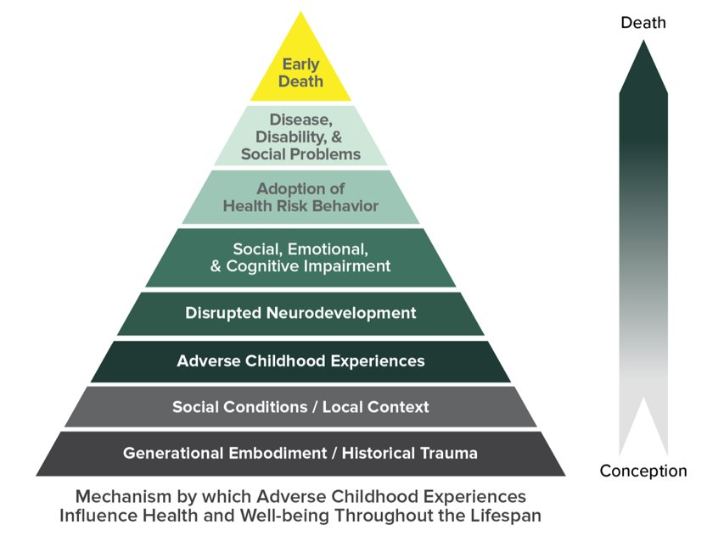
ACEs
How do childhood experiences lead to these rates of worsened health in adulthood?
Notes:
ACEs: Outcomes
Level: Intermediate/Clinical
Discussion
Feletti et al. and other sociologists and psychologists observed that abuse and other negative childhood experiences were related with worse health and social outcomes in adulthood. This pyramid was developed to explain why that may be.
Adversity, specifically abuse, neglect and other household dysfunction (the 10 ACEs from previous slides) have an impact on child development.
Specifically they impact neurobiological development – this can include stress tolerance, emotional regulation and learning. When the brain is focused on survival and managing stressors, the neural pathways that support learning can be underdeveloped and this can impact learning and the ability to problem solve.
Psychosocial effects include attachment and the ability to develop and maintain relationships, social and relationship skill deficits may be present.
Adversity impacts problem solving and stress management skills. Exposure to adversity can lead to increased health risk behaviors – these includes smoking, substance use, early sexual behavior or risky sexual behavior
Together this developmental impact has long term consequences into adulthood that include disease, disability and a whole host of social problems
Sources:
Centers for Disease Control [CDC]. (2021, April 6). About the CDC-Kaiser ACE Study. https://www.cdc.gov/violenceprevention/aces/about.html

Slide 6
Addressing Toxic Stress
Safe, stable nurturing relationships buffer
Honestly talk about difficult things
Screening, early detection and effective interventions to help people heal
Assure environments are nurturing, stable and engaging
(Burke-Harris, 2018)
Notes:
ACEs: Toxic Stress
Level: Intermediate/Clinical
Discussion
Dr Nadine Burke-Harris’s key strategies for addressing toxic stress.
To address Toxic stress, se need to focus on supporting safe, stable and nurturing relationships. These relationships serve as a buffer for toxic stress.
We need to honestly talk about difficult things with children and their families.
A focus on screening, early detection and effective intervention to help people heal is important.
And we need to support and assure that children are in environments that are nurturing, stable and engaging. Of course this means that we are supporting caregivers in acquiring the resources and developing the skills to create these environments for their children.
Optional Video
TED [TED Channel]. (2015, Feb 17). Nadine Burke Harris: How childhood trauma affects health across a lifetime. https://www.youtube.com/watch?v=95ovIJ3dsNk
Sources:
Sourced from: Williams-Hecksel, C. (2021, Nov 1). Trauma Informed Teaching. [PowerPoint].
Burke Harris, N. (2018). The Deepest Well: Healing the Long-Term Effects of Childhood Adversity. Mariner Books.
Felitti, V. J., Anda, R. F., Nordenberg, D., Williamson, D. F., Spitz, A. M., Edwards, V., Koss, M. P., & Marks, J. S. (1998). Relationship of childhood abuse and household dysfunction to many of the leading causes of death in adults. The Adverse Childhood Experiences (ACE) Study. American journal of preventive medicine, 14(4), 245–258. https://doi.org/10.1016/s0749-3797(98)00017-8

